Slide 1
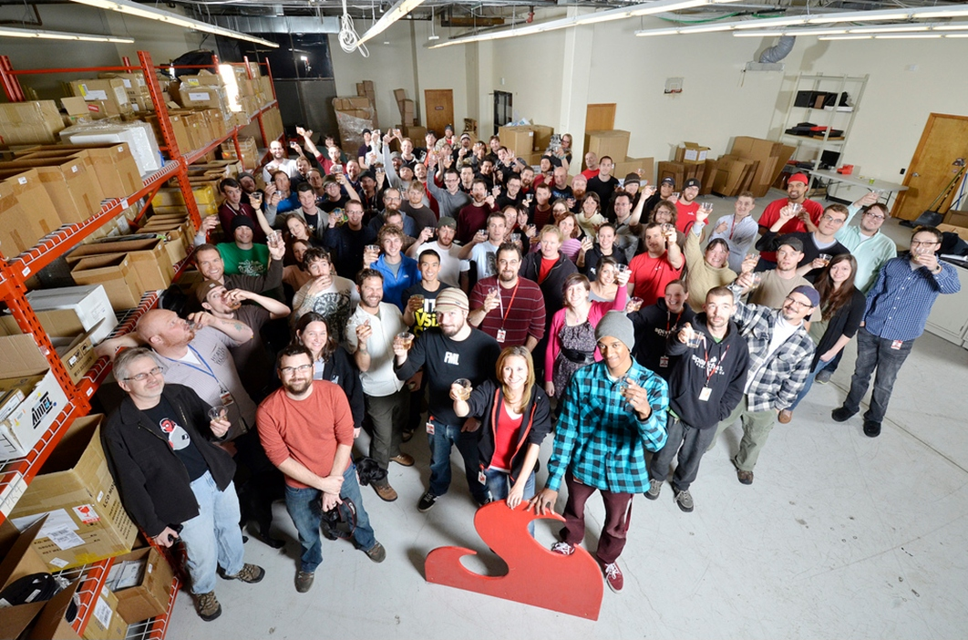

Slide 2
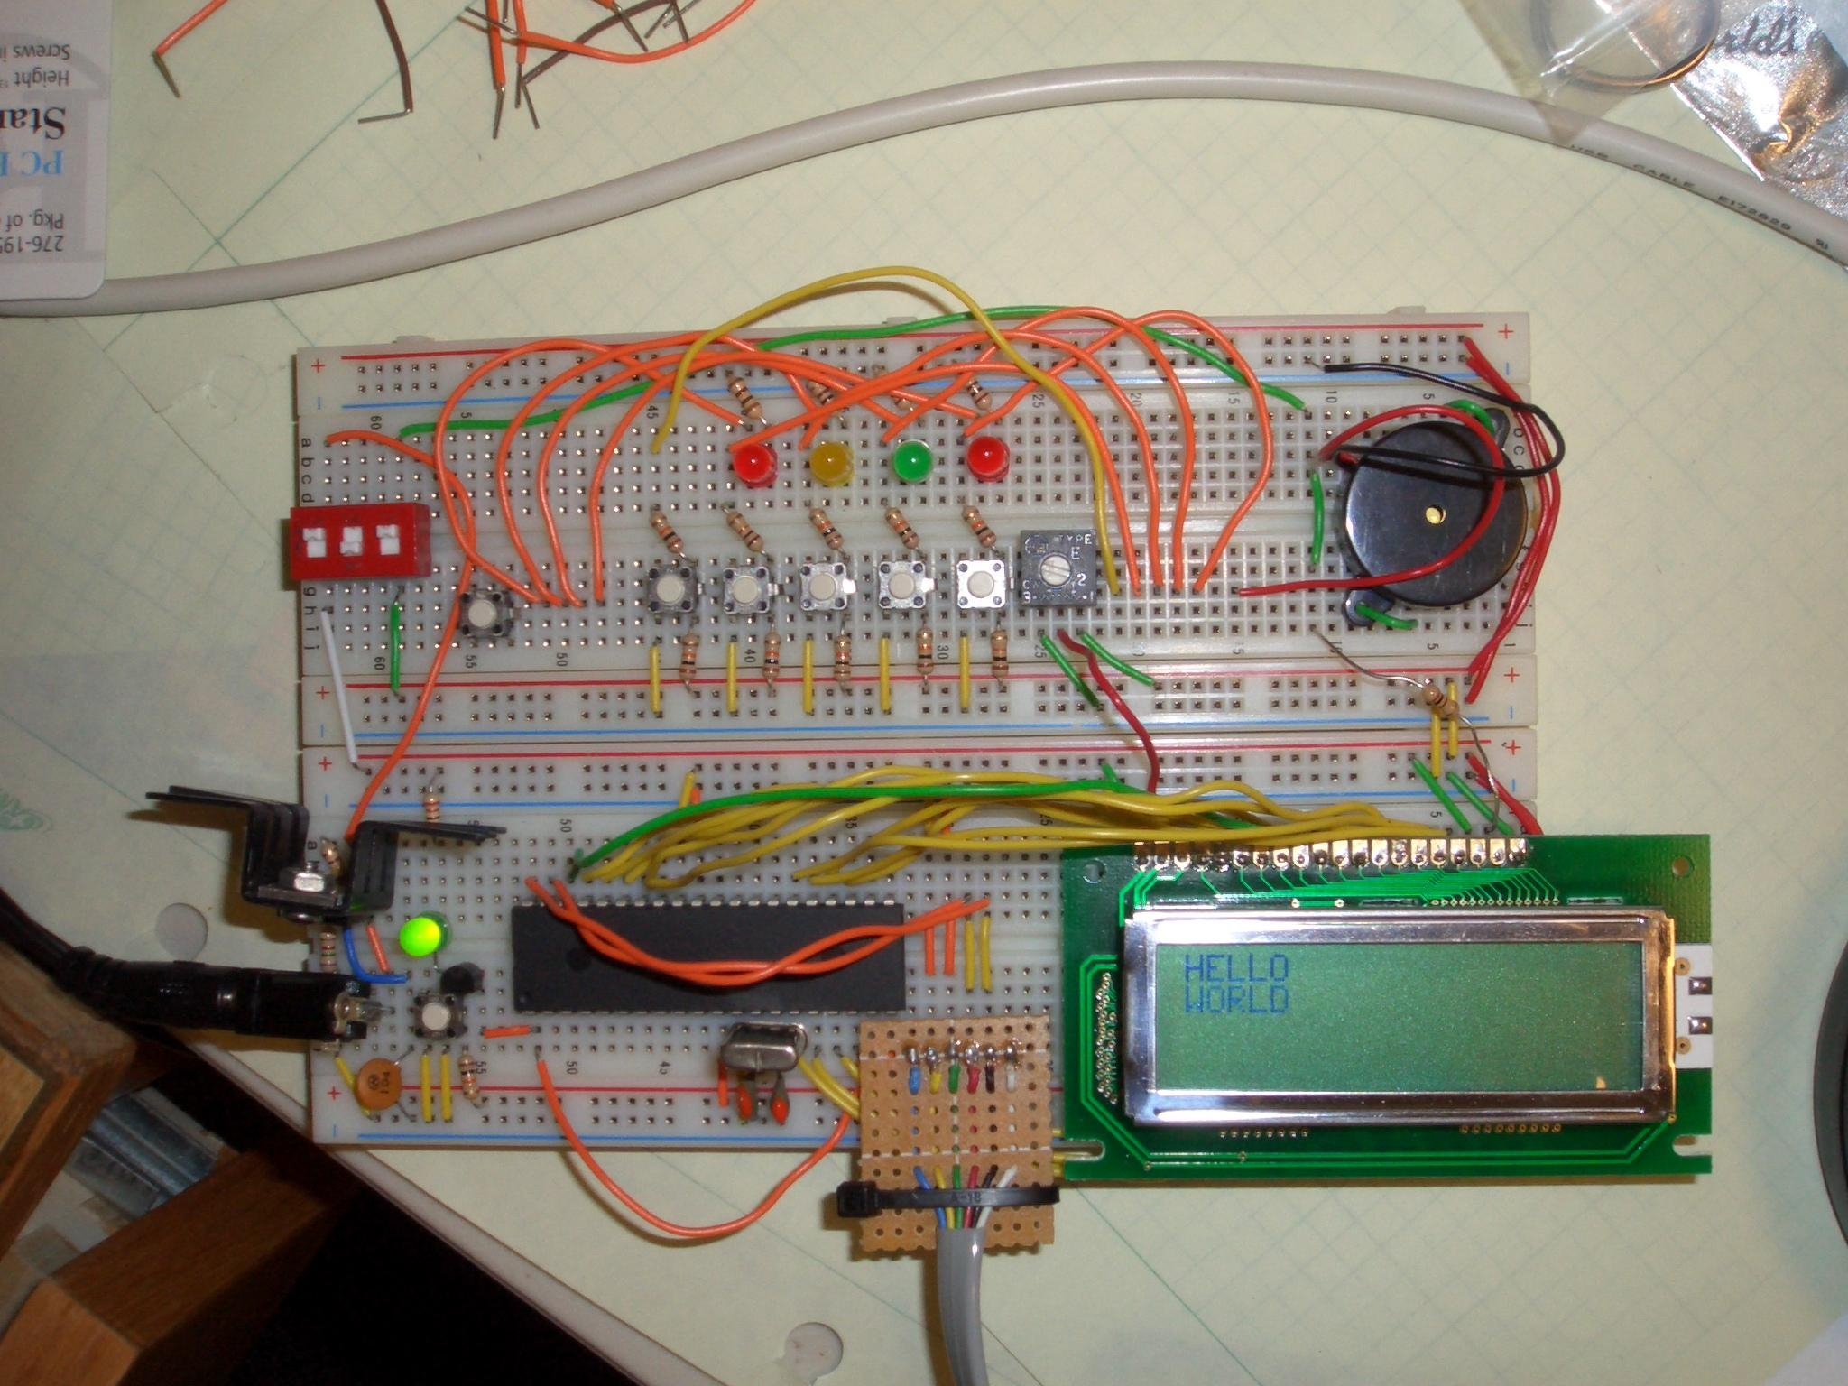

Slide 3
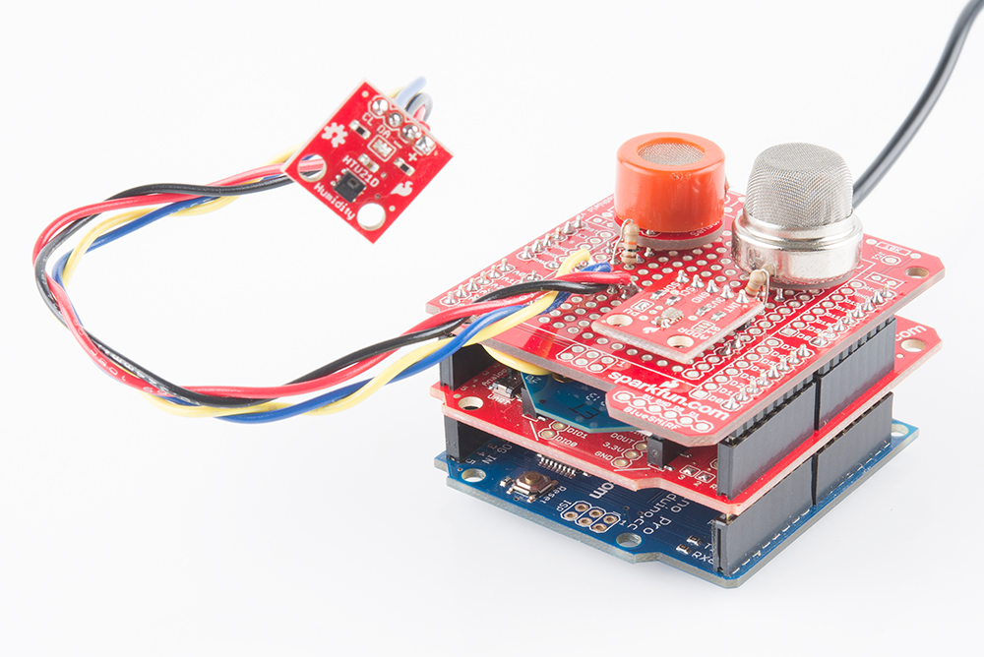

Slide 5
10 things I’m pretty sure I learned about engineering while working in industry

Slide 6
1. Soldering

Slide 7


Slide 8
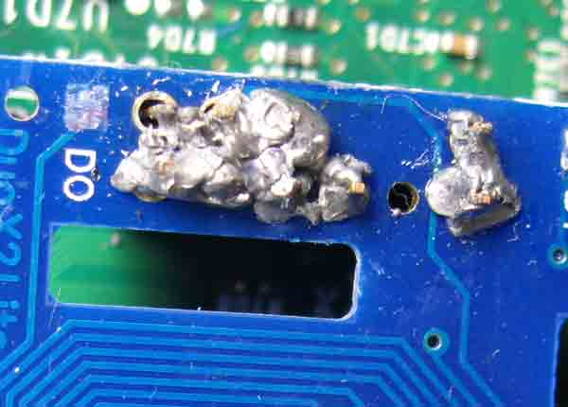

Slide 9
Engineers and Technicians

Slide 10
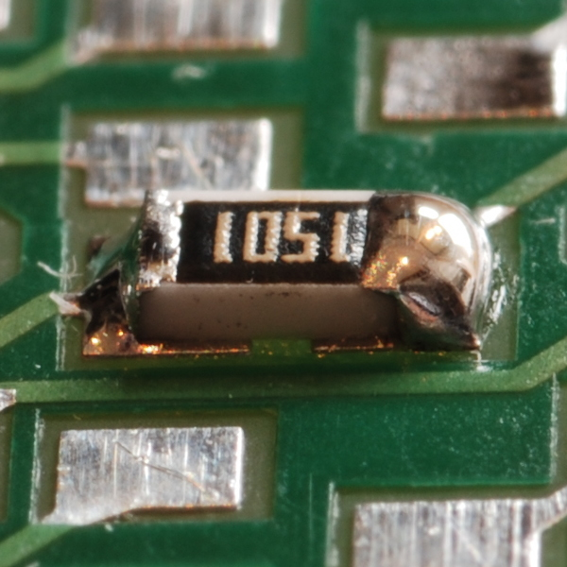

Slide 11

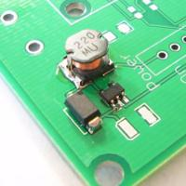
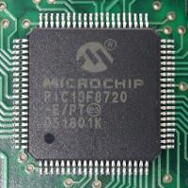
Soldering Class!

Slide 12


Slide 13
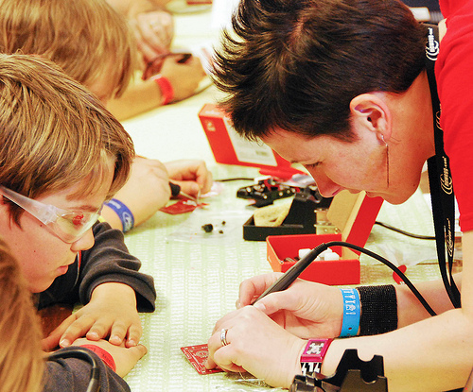
Why?
Better at designing
Work with techs
Sweet skill

Slide 14
Get hands-on experience

Slide 15
2. Computer-Aided Design

Slide 16
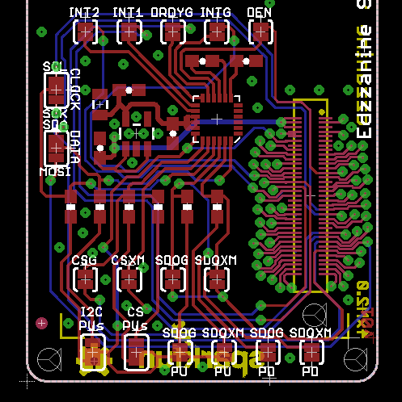
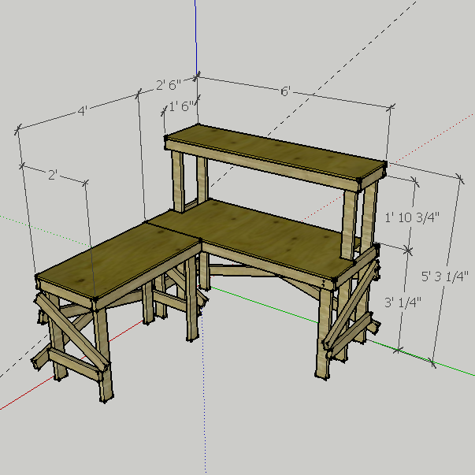
PCB Layout
3D CAD

Slide 17


Free PCB CAD Programs
EAGLE
KiCad

Slide 18
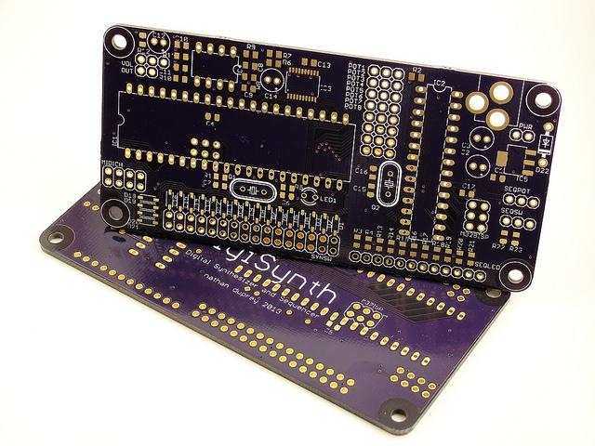
Small Batch PCB Ordering
OSH Park
ITEAD Studio

Slide 19
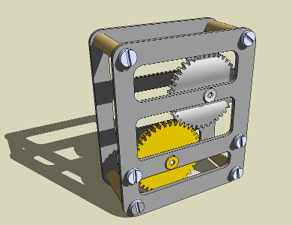
Free 3D CAD Programs
Sketchup
Blender
OpenSCAD
pt.wikipedia.org

Slide 20
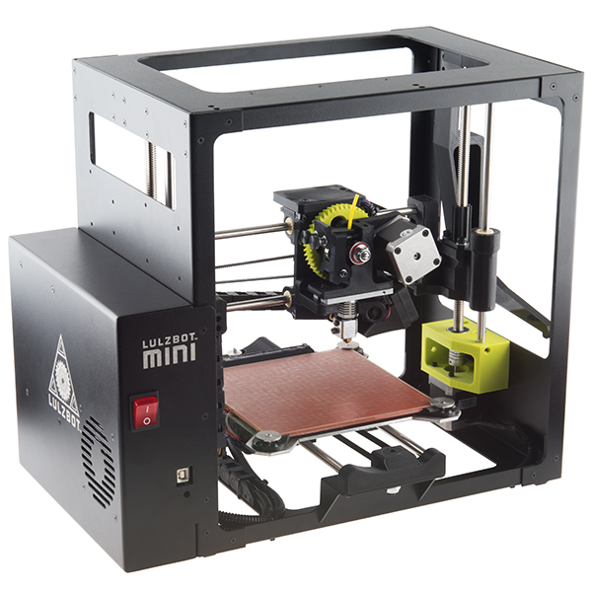
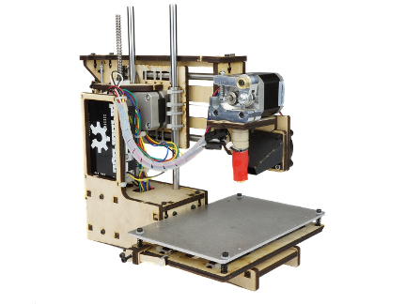
3D Printers
LulzBot Mini
$1375
PrintrBot Simple Maker’s Kit
$350

Slide 21
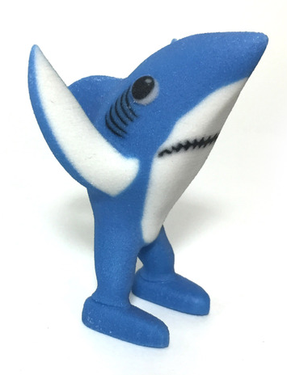
3D Printing Services
Shapeways
Sculpteo
shapeways.com

Slide 22
Learn some form of CAD

Slide 23
3. Programming

Slide 24
Engineering requires programming

Slide 25
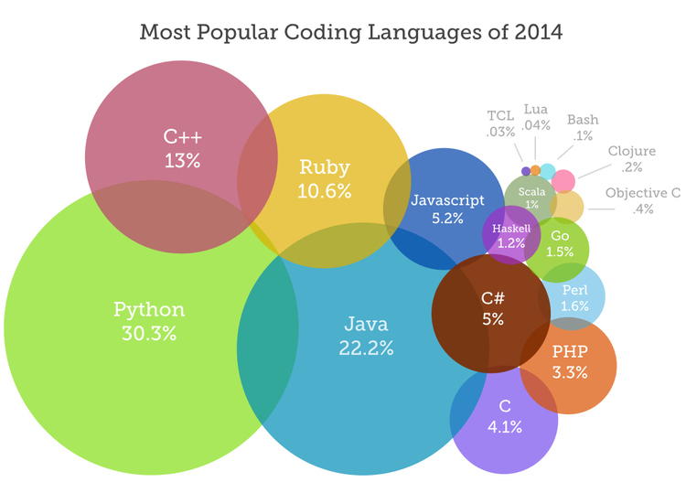
www.codeeval.com

Slide 26

Your friend, MATLAB

Slide 27
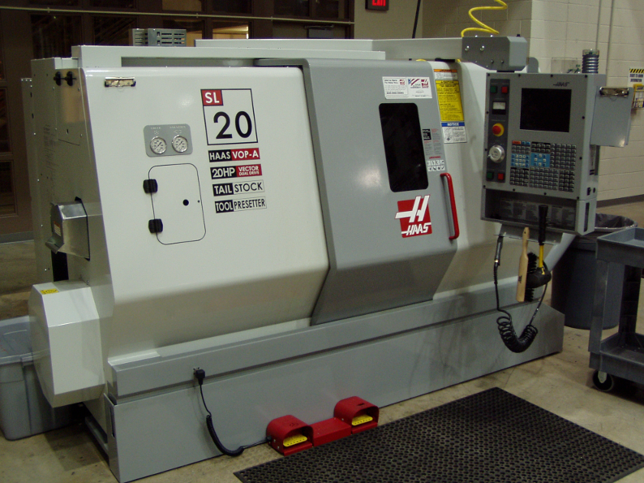
guess what this is...
www.wikipedia.org

Slide 28
Your first language is the hardest

Slide 29
4. Teaching Yourself

Slide 30
Schools do not teach you how to teach yourself

Slide 31
Self-teaching is an
unstated qualification

Slide 32
www.codeeval.com

Slide 33
Job Posting - Lockheed Martin
Circuit Design Engineer Sr
Basic Qualifications
Bachelors degree from an accredited college in a related discipline. Significant experience with analog, digital, and mixed signal design, simulation, and PCB (printed board circuit) design and layout, … Excellent communication skills.
Desired skills
Experience with MATLAB, … , Electro-optical products, Infrared sensor products, … .

Slide 34
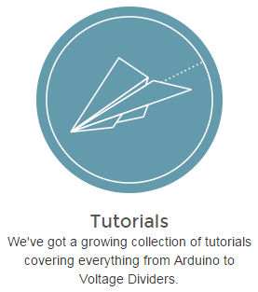
How?
Pay attention!
Books (Amazon)
Free sites
Friends
learn.sparkfun.com

Slide 35
Learn how to teach yourself

Slide 36
5. Right Brain Stuff

Slide 37
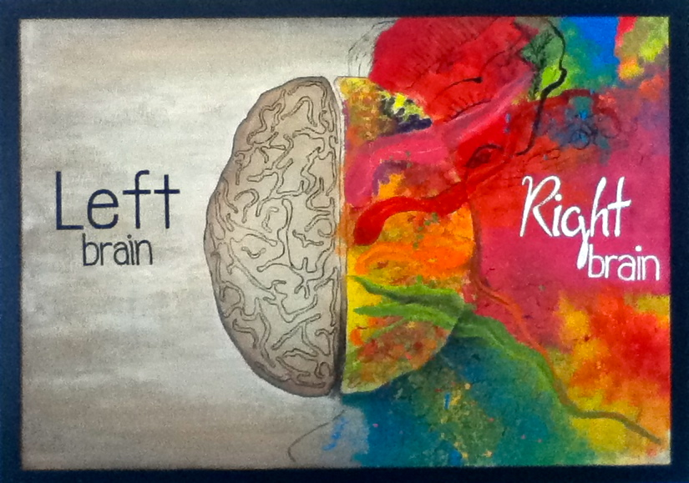
msaelee.deviantart.com

Slide 38


Slide 39
Pick a Creative Hobby
Dance
Paint
Write poetry
Play an instrument

Slide 40
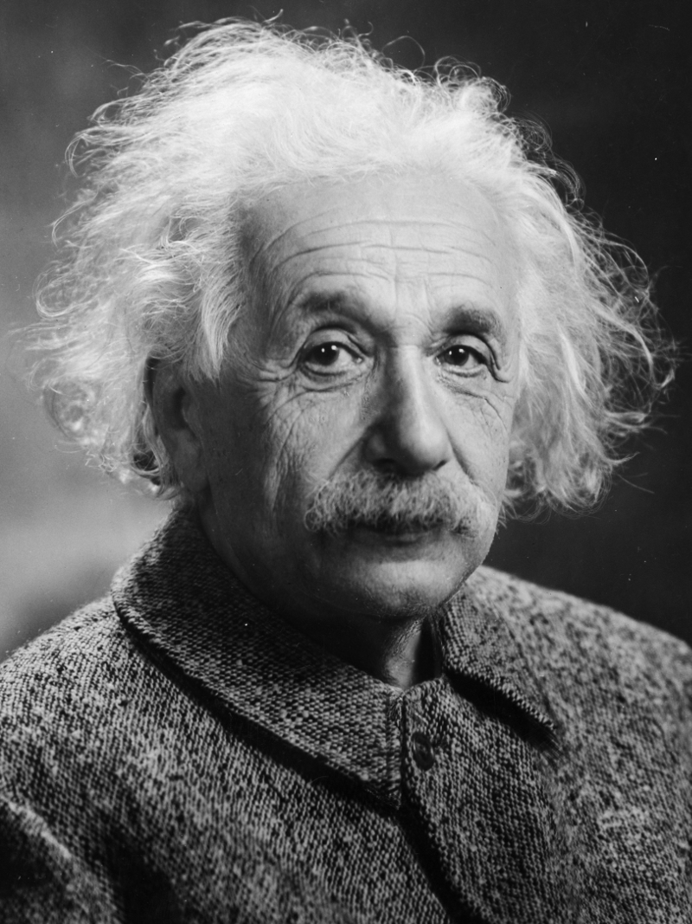
“The intuitive mind is a sacred gift and the rational mind is a faithful servant.
We have created a society that honors the servant and has forgotten the gift.”
- Albert Einstein

Slide 41
Nurture your creativity

Slide 42
6. Move

Slide 43

Source: tv.com

Slide 44
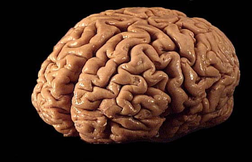
Plenty of Benefits
Less stress and anxiety
Helps mood and sleep
Improves memory and learning
Sanandros, wikipedia.org

Slide 45
Move your body

Slide 46
7. Know Thyself

Slide 47
Mood affects the way we work

Slide 48


Slide 49
Measure of a person’s ability to perceive, control, evaluate, and express emotions

Slide 50
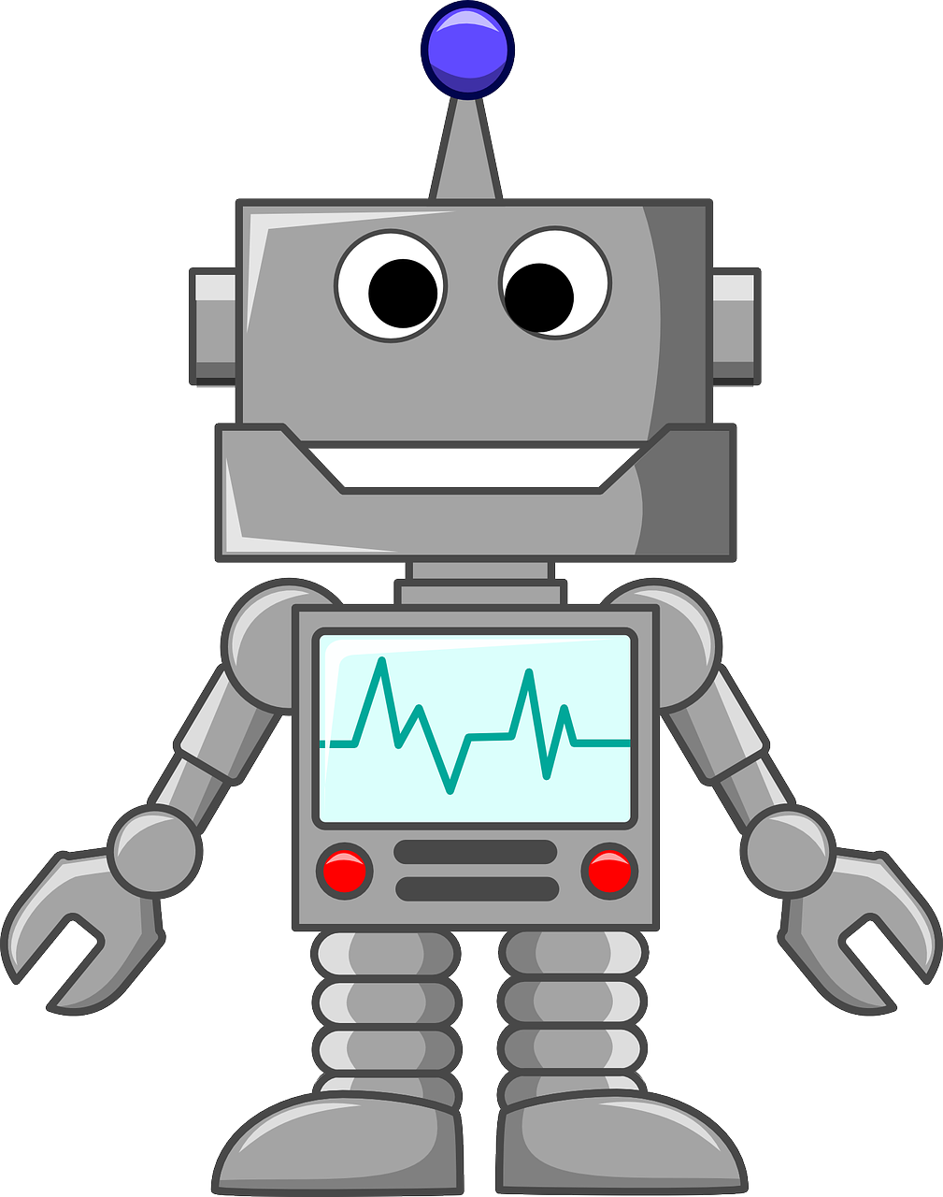

Slide 51
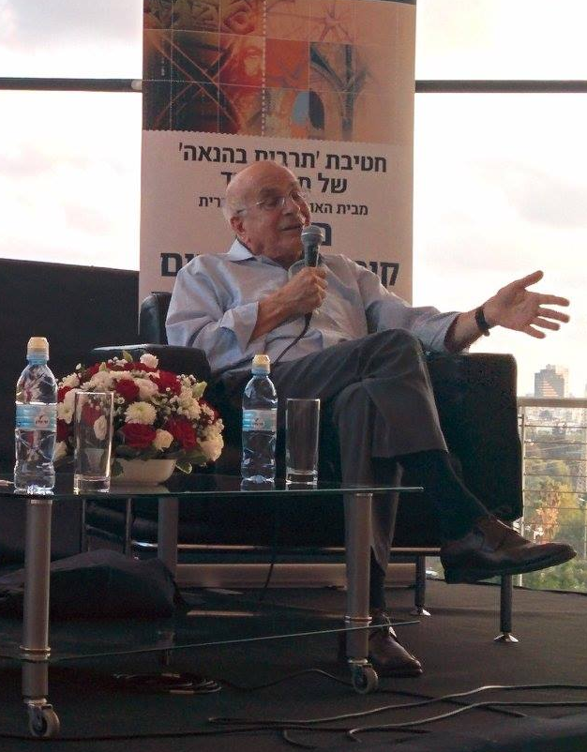
Ohadinbar, wikipedia.orgg

Slide 52
Why should I care?
Interviewing
Asking for a promotion
Talking about designs
Working on a team

Slide 53


What should I do?
How do you handle your feelings?
Read
See a therapist
www.roads.co
www.goodreads.com

Slide 54
Invest time in yourself

Slide 55
8. Business and Marketing

Slide 56
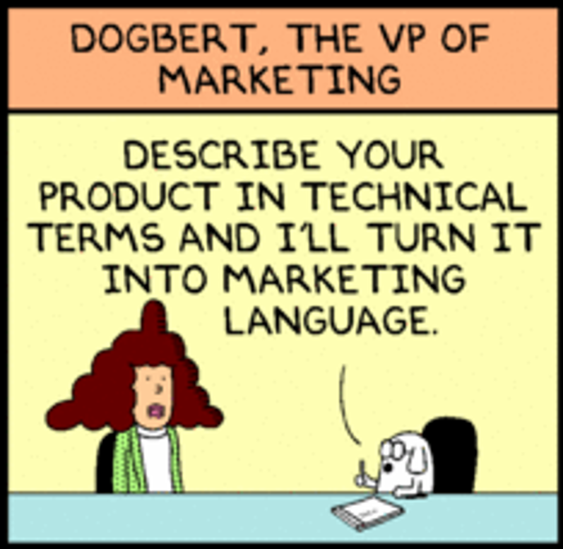

Slide 57
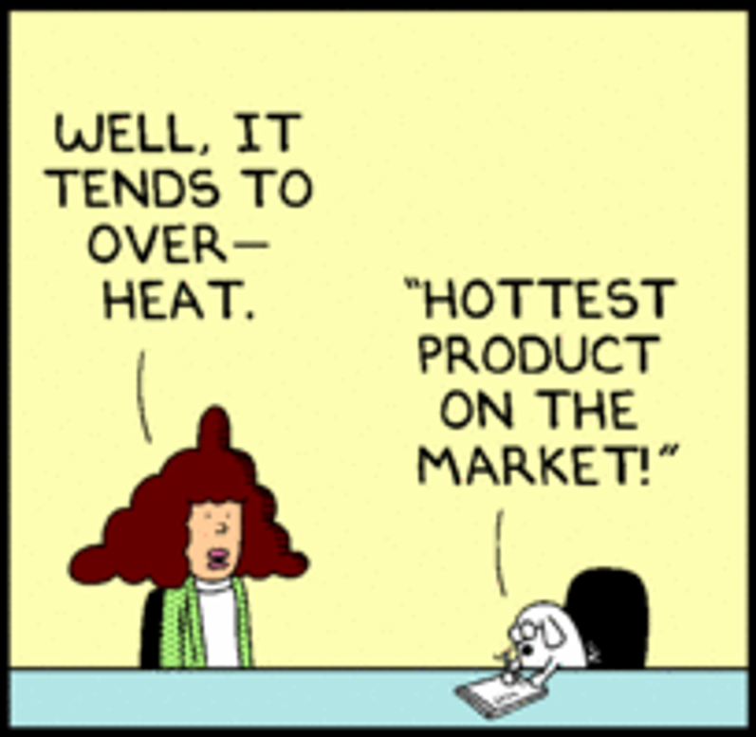

Slide 58


Slide 59
Misconception #1
Marketing
Engineering

Slide 60
Misconception #2
If you build it, they will come

Slide 61
Fixes
“If you build it…” does not exist
Learn something about business

Slide 62


Where to Learn
Business class
Books
Blogs
trackmaven.com
edcapaldi.com

Slide 63
Build business sense

Slide 64
9. Public Speaking

Slide 65
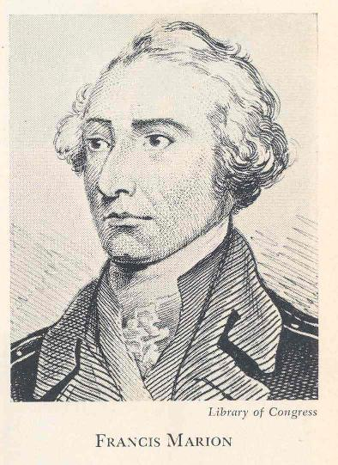

Slide 66


Slide 67
You will have to speak in front of a crowd at some point in your career

Slide 68
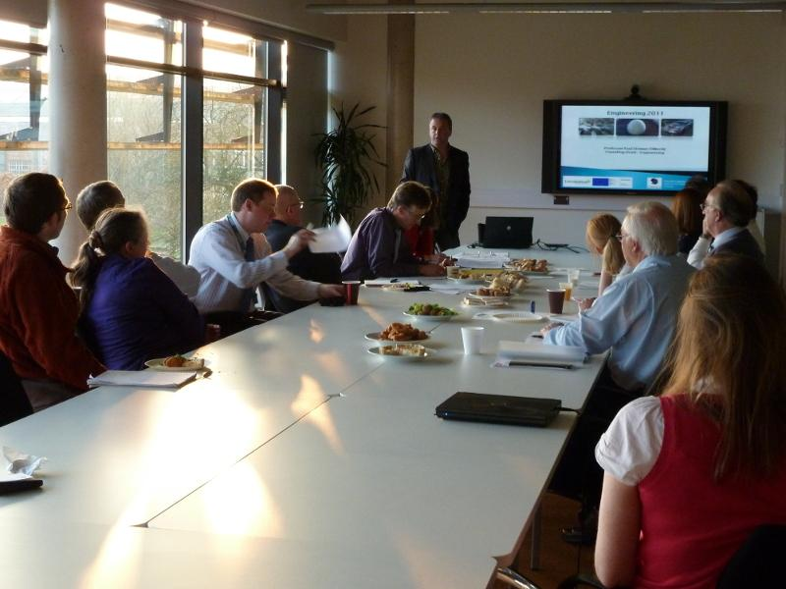

Slide 69
Public speaking is an underrated skill

Slide 70


Slide 71


Slide 72
Find your voice

Slide 73
10. Sharing is Caring

Slide 74
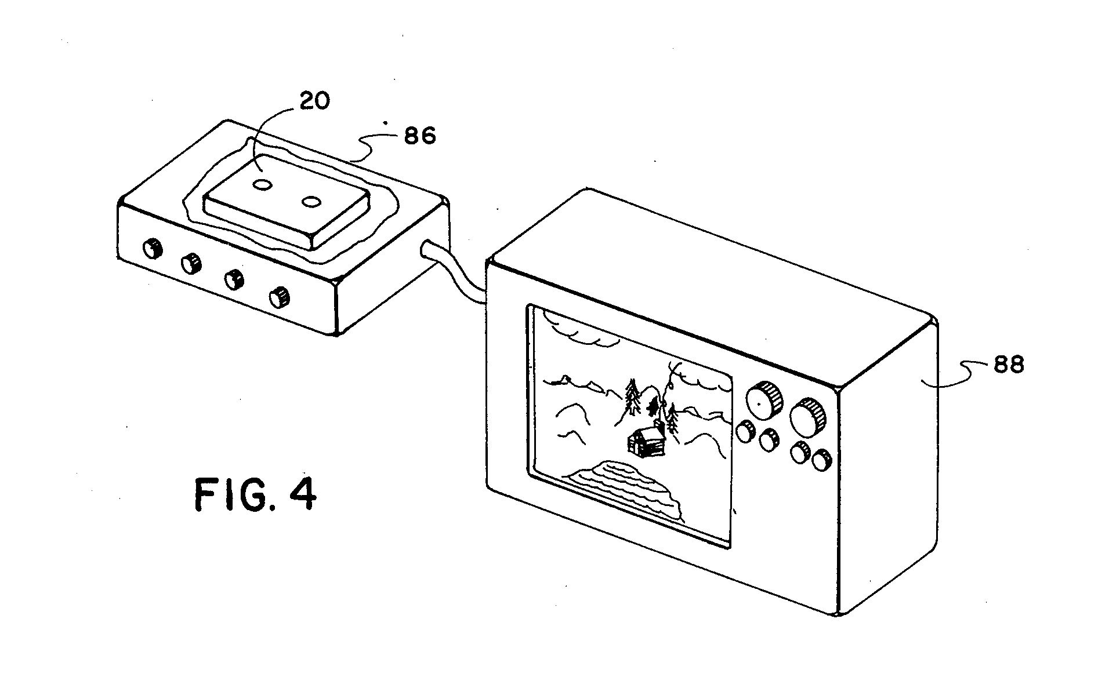
Patent: US 4131919 A

Slide 75
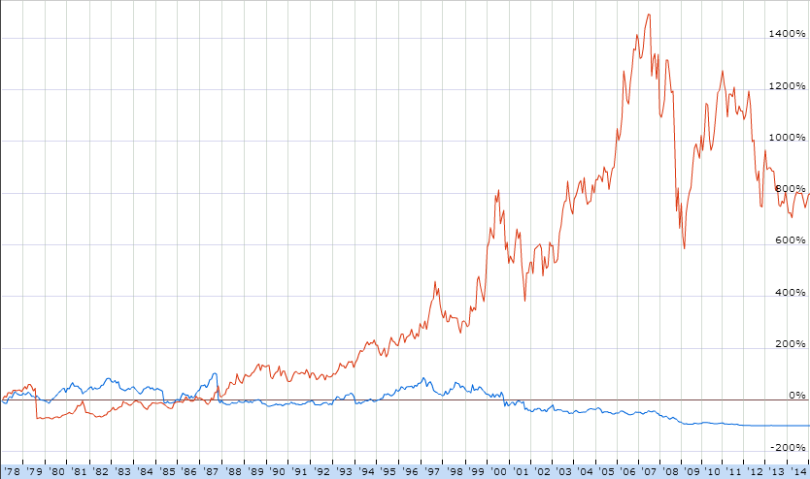
Percentage Growth
Year
Source: google.com/finance

Slide 76
The patent system is antiquated
(at least in electronics)

Slide 77
Open Source
Provide plans
Allow for modification
Able to be sold
Propagate license

Slide 78
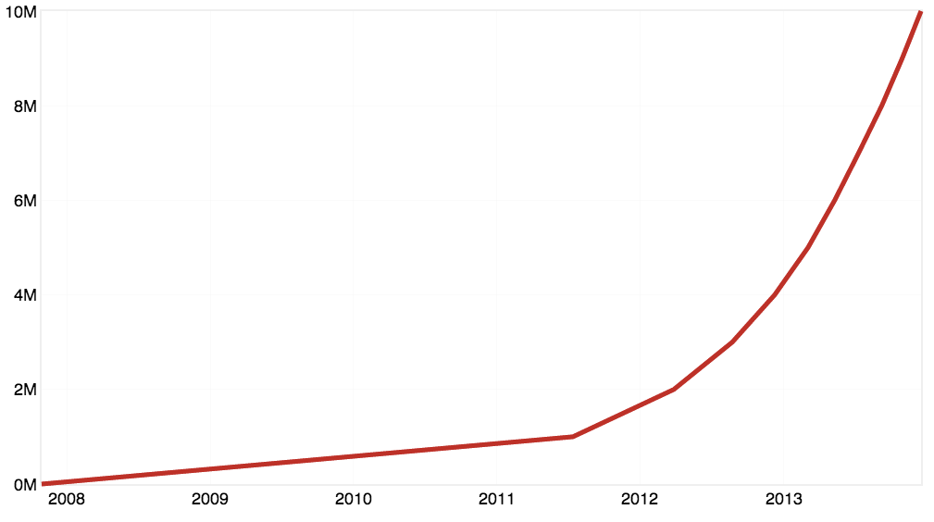
Repositories on GitHub
github.com
Year

Slide 79




Slide 80



Slide 81


Slide 82

OpenROV
startup88.com

Slide 83
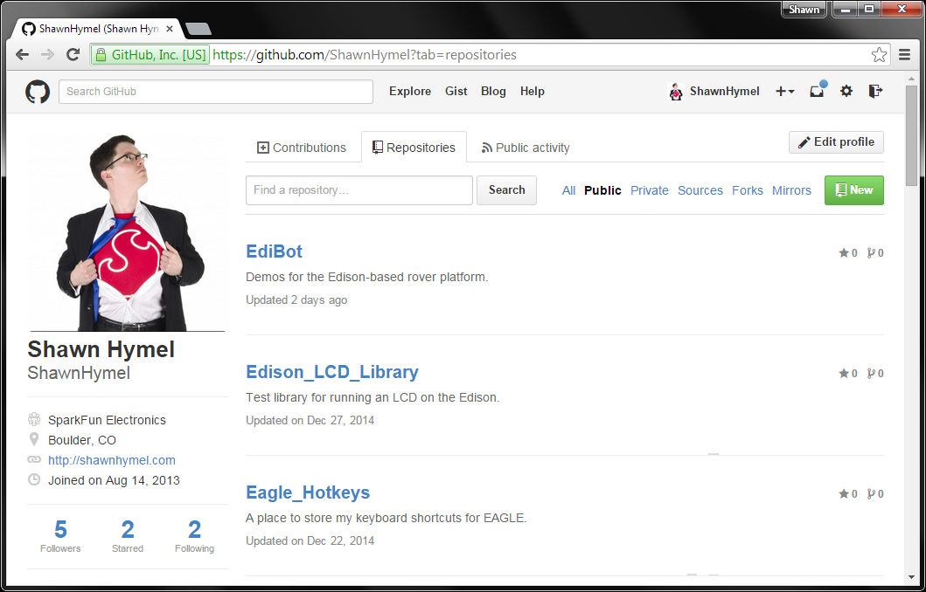

Slide 84
Start Your Own Business
EDN Interview with Limor Fried (Adafruit) on starting your own electronics kit business

Slide 85
Open source drives innovation

Slide 86
Soldering
CAD
Programming
Teaching Yourself
Right Brain Stuff
Move
Know Thyself
Business & Marketing
Public Speaking
Sharing is Caring

Slide 87


Contact me
shawnhymel.com
@ShawnHymel

